Slide 1

Quantum and AI Enhanced Handwritten Recognition To Detect Mental Health

Slide 2
Where handwriting meets the mind
Mental health states leave distinctive signatures in handwriting patterns—from stroke intensity and pressure variations to spacing consistency and letter formation. These subtle markers provide a window into emotional well-being.
By combining AI's exceptional pattern recognition capabilities with quantum computing's superior computational power, we can detect four key emotional states: Happy, Sad, Angry, and Stressed.
AI’s
Pattern recognition capabilities
Quantum computing's superior computational power
Detecting Emotion States
Our Approach

Slide 3
AI powered recognition
Dataset
EMNIST foundation enhanced with emotion-specific augmentation covering Happy, Sad, Angry, and Stressed states. Trained on 20,000+ real handwriting samples.
Convolutional Neural Network (CNN)
Purpose-built Convolutional Neural Network achieving 95% classification accuracy. Optimized for emotional nuance detection in handwriting patterns.
Technology Stack
PyTorch for deep learning, OpenCV for image processing, NumPy for computation, Scikit-Learn for validation. Flask deployment enables real-time predictions.

Slide 4
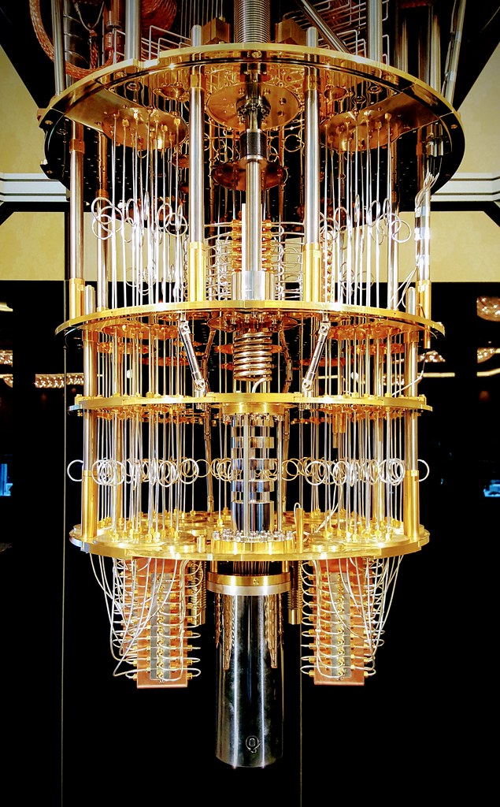
Quantum computing
A quantum computer isn't just a more powerful version of the computers we use today; it's something else entirely, based on emerging scientific understanding -- and more than a bit of uncertainty.
Quantum computing uses principles of quantum mechanics to process information.
Instead of classical bits (0 or 1), it uses qubits, which can exist in multiple states at once.
Promises to solve complex problems much faster than traditional computers.

Slide 5
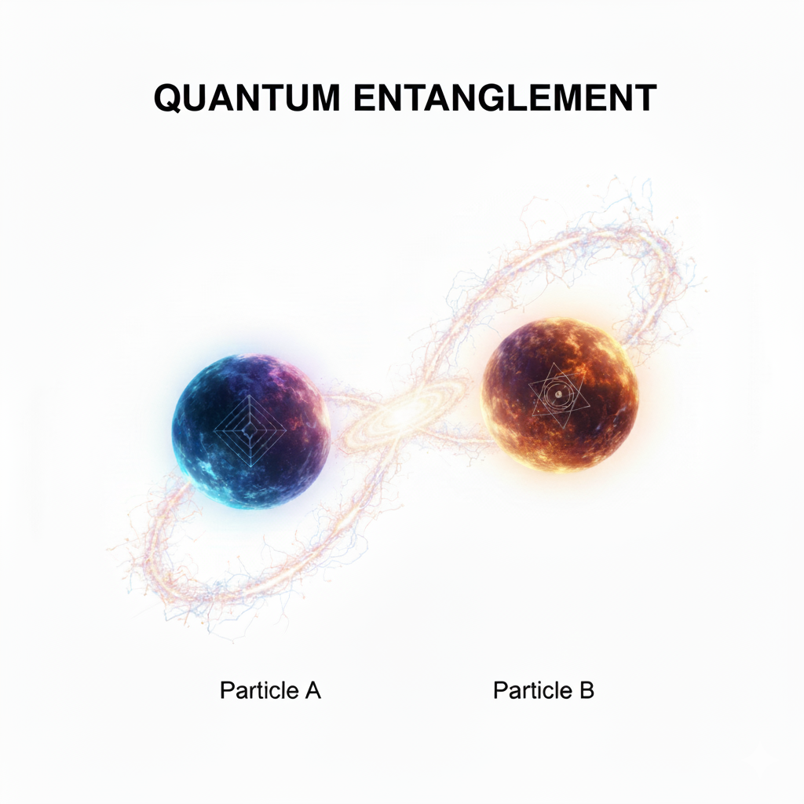
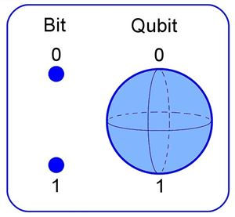
Quantum computers Concepts
Superposition
A Qubit can be in a combination of 0 and 1 simultaneously.
Entanglement
Linked qubits can influence each other instantly, even when far apart.
Quantum Interference
Used to amplify correct solutions and cancels out wrong ones.
Classic Bit and a Qubit

Slide 6
Quantum computing breakthrough
Feature Reduction
PCA dimensionality reduction to 8 principal components
Quantum Encoding
8 components mapped to 8-qubit quantum circuit
VQC Training
Variational Quantum Classifier built using Qiskit framework
Remarkable Results
100% accuracy on optimized quantum dataset.
Simulated on local quantum backend with scalability to IBM Quantum cloud infrastructure for future deployment.

Slide 7
Quantum Pipeline
Data Preprocessing
Image normalization, noise reduction, and feature extraction from real handwritten samples.
Emotion Augmentation
Dataset enhancement with four emotional states labels and variations.
Model Processing
Parallel CNN and VQC analysis paths for comprehensive evaluation.
Flask backend seamlessly connects the AI/Quantum models with an intuitive web interface, enabling instant handwriting-to-emotion analysis.
Prediction Output
Real-time emotional state classification with confidence scores.

Slide 8
Results & observations
95%
CNN Accuracy
Stable validation performance across all training epochs.
100%
Quantum Accuracy
Perfect classification on reduced high-quality dataset.
20K+
Training Samples
Diverse handwriting examples for robust model training.
Insights
Pattern Recognition Success
Emotion recognition strongly correlates with expected handwriting characteristics—stressed writing shows increased pressure, happy writing displays smoother strokes.
Areas for Refinement
"Sad" emotions show slight over-prediction tendency. Enhanced dataset balancing and additional training samples can further improve classification precision.

Slide 9
Conclusion & future scope
Handwriting as Mental Health Indicator
Empirical validation that emotional states manifest in measurable handwriting characteristics.
Dual-Technology Validation
Both AI and Quantum approaches demonstrate reliable emotion recognition capabilities.
Clinal Application Potential
Foundation established for objectives, automated mental health screening tools.

Slide 10
Thank you
Presented By-
Sanchit Karwasra
Manvi Singh
Shourya Solanki
Bhoomi Jindal

